Slide 1
Senior Business Insights Analyst At Home Assignment (Pavan Naik)

Slide 2
EDX

Slide 3
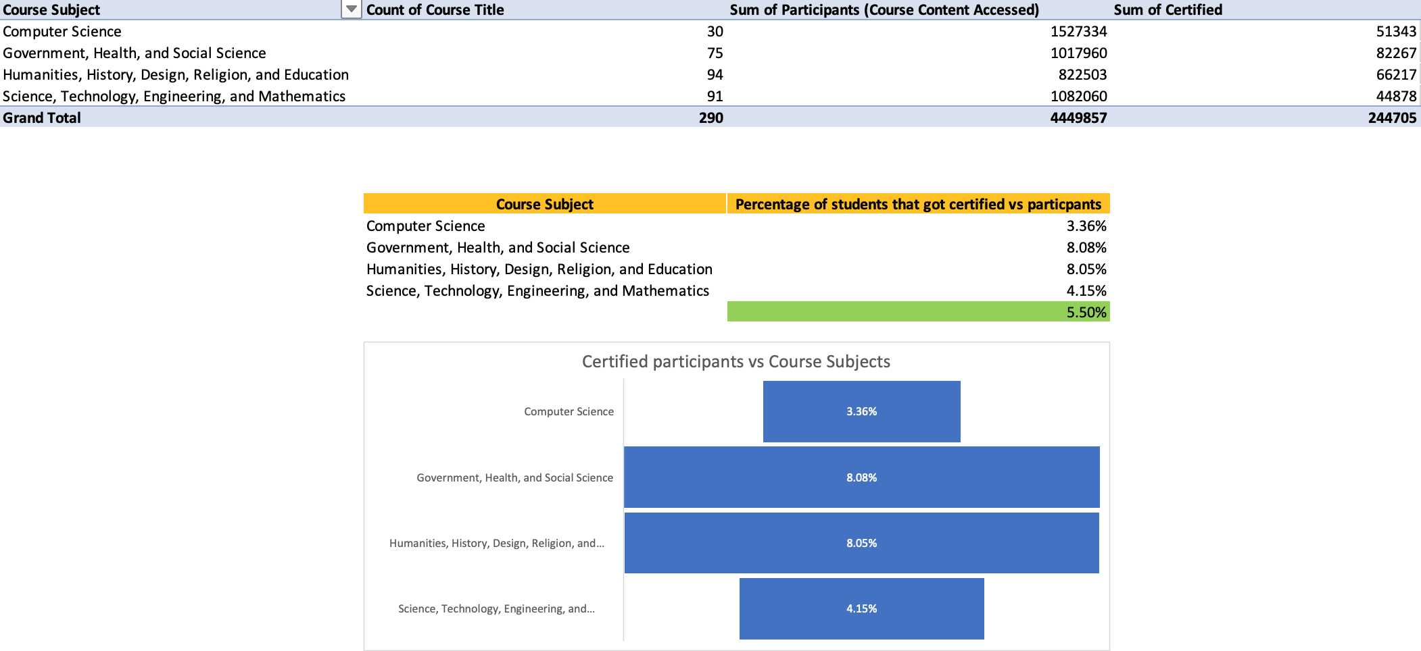
Participants vs Course Subjects
It can be observed that the courses offered on EDX are categorized into four major subjects, of which most participants enrolled/accessed the computer science stream.
Majority of participants certified were either enrolled in Government, Health and Social Science or Humanities, History and Education related coursework.
Though many participants enrolled for the computer science course, they have not been certified or have failed to complete the course.

Slide 4
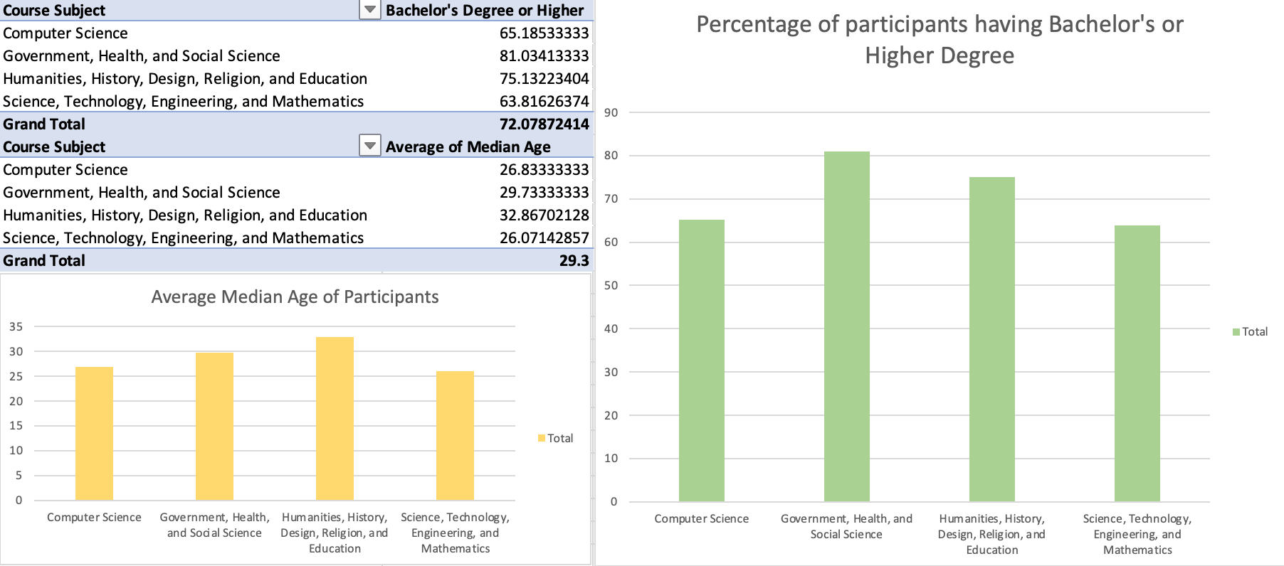
Age and Degree of Participants
Most of the participants had a Bachelor’s degree or higher and were of of 29 years of age on an average. This means that our primary target could be working people that are seeking additional skills to advance in their career.

Slide 5
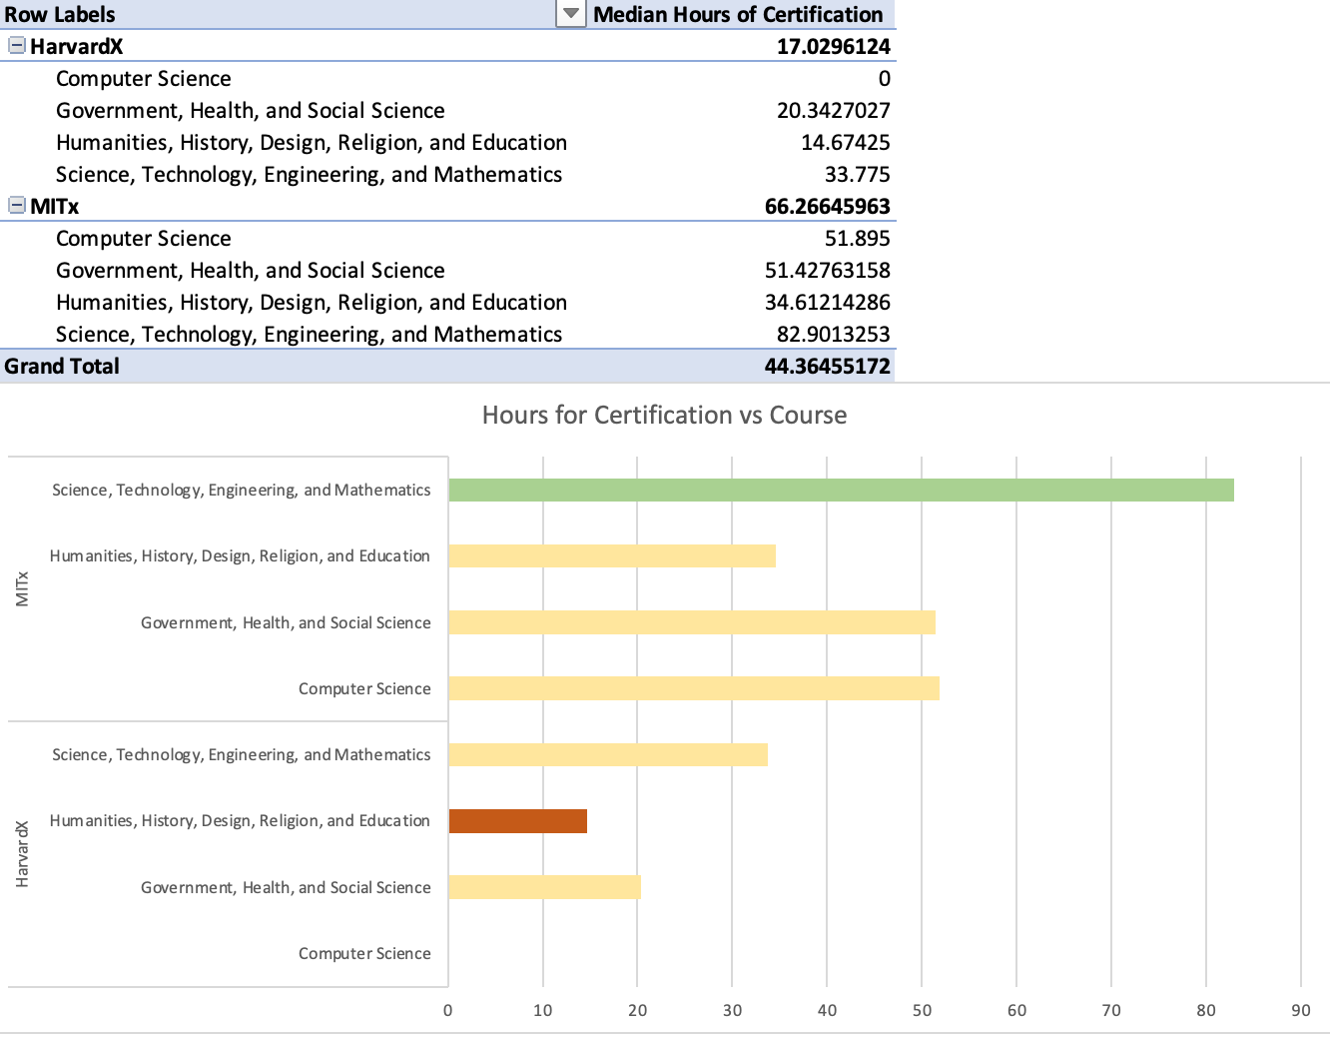
It can be observed that participants are more likely to take a course that is of shorter duration as in case of STEM courses offered by both institutions.
Also, as seen previously Humanity, History or Government, Health and Social Sciences had more completion rate which could be a result of the less duration in addition to the interest participants had towards these courses.
Red indicates the average time in hours for the course completion time with shortest duration;
Green shows the average tome in hours for the course completion time with largest duration

Slide 6
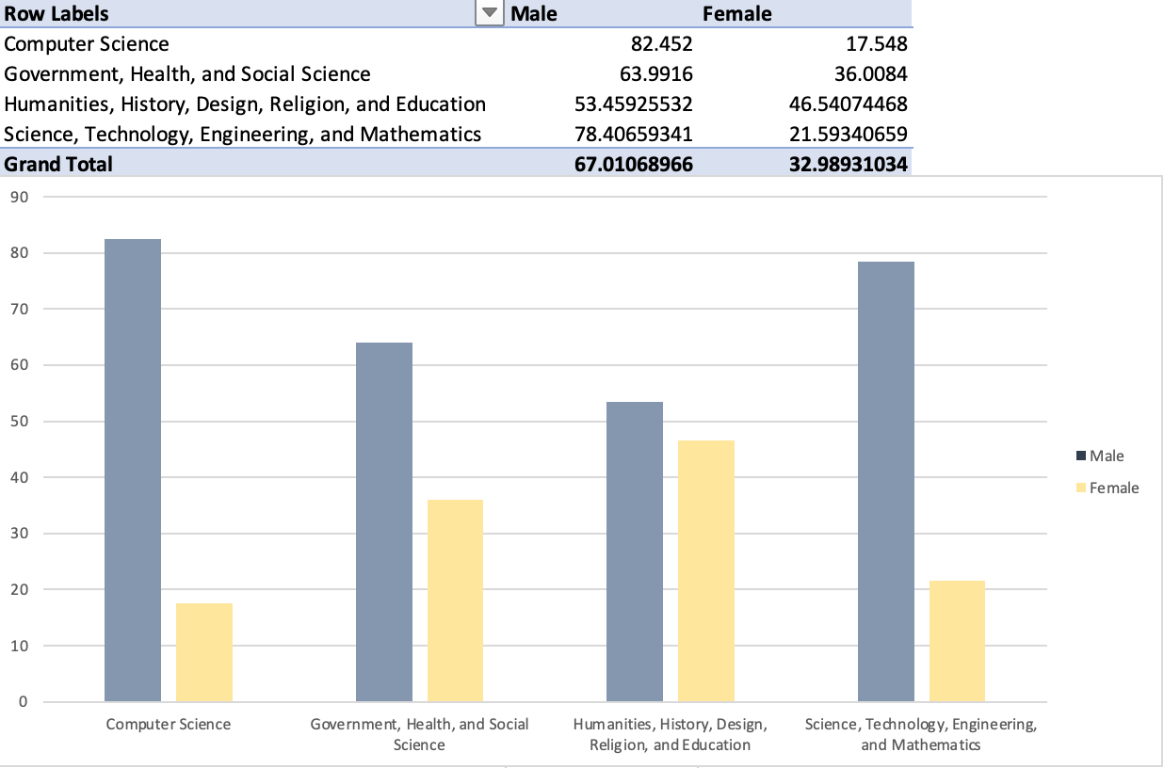
The male population is more likely to enroll in a STEM or Computer Science course as compared to the Female population. Also, on an overall basis the Male population is more likely to enroll for a course.

Slide 7
Udemy

Slide 8
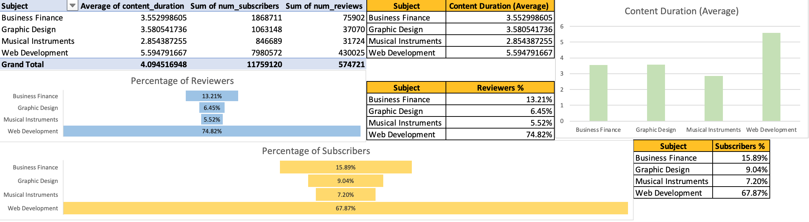
Most participants showed interest in Web Development courses as compared to other courses offered. This could be a result of the growing technological skills/ introduction of new programming languages/tools offered in the market.
Irrespective of the duration participants are more likely to learn Web Development.
Reviews can be deceptive to account in this case as it could show either about a participant liking the course or disliking it. But participants did review after subscribing to a course that translates to their interest in learning from the course.

Slide 9
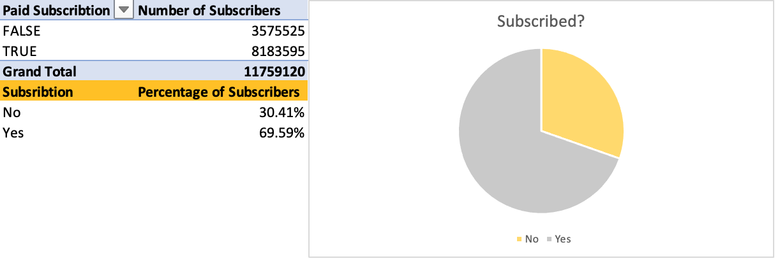
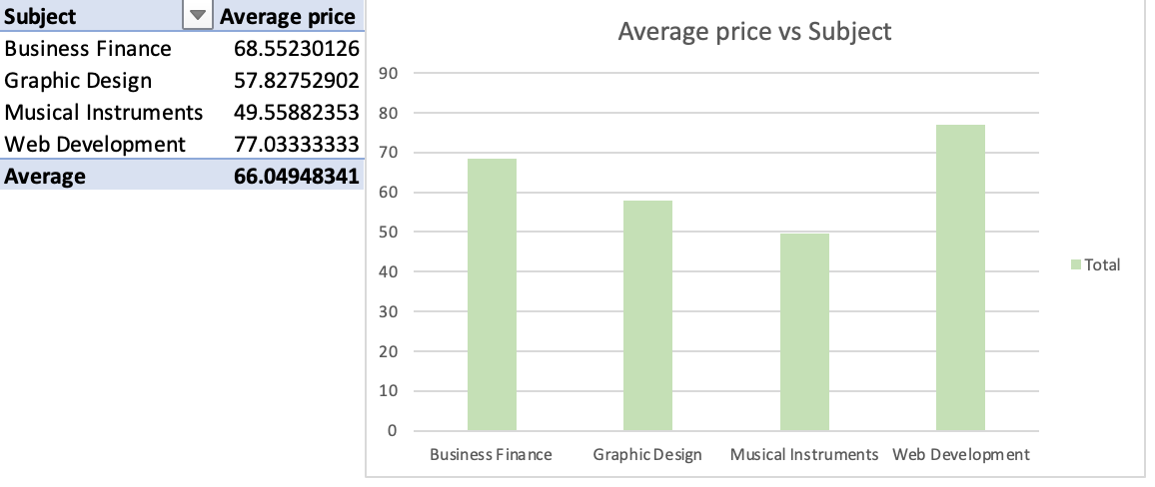
It can be observed that participants do not mind paying the subscription fees if the course offered interests them.
On an average the course price was around $66.

Slide 10
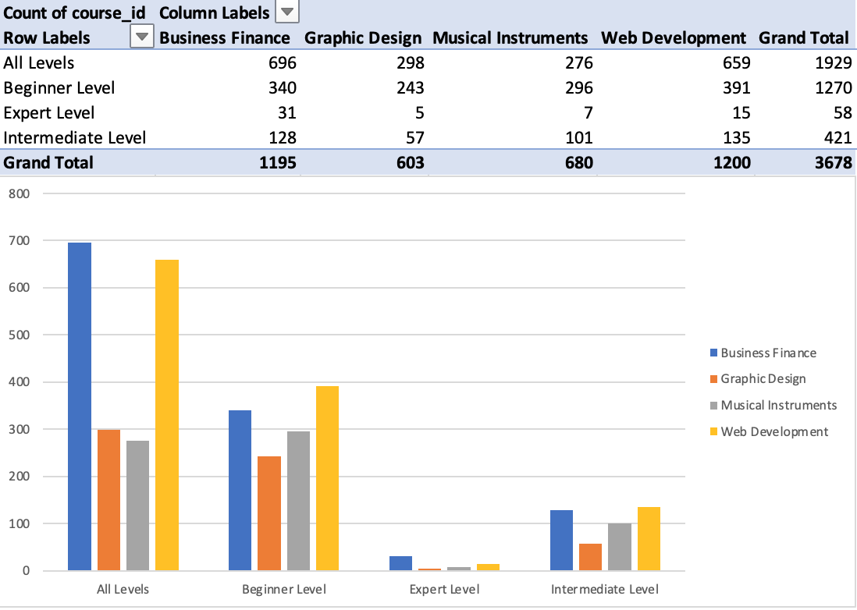
The increase in the number of participants with Web Development course could be due to the number of courses offered in that domain, which in this case is around 1200.

Slide 11
Key takeaways from the analysis:
Courses offered are more likely to be taken by participants who have a Degree and are working/of the age 25-35.
Male population are more likely to enroll in a course.
Computer Science and other STEM courses are in growing demand ( Courses related to new technologies/ tools could be offered). In addition to that the courses are likely to be completed if they have shorter duration.
Subscription fees to enroll has not been a major flaw for a participant to enroll.
Courses that have been successful belonged to the domain Web Development (Computer Science) – as the enrollment rate and the completion rate of History, Education, Health and Social Services courses were higher.
A good blend of the courses offered would drive more participants to enroll (e.g. Computer Science in the Health Domain; A SQL course with accessing the patient’s data would make it domain specific, or a Python visualization course with marketing metrics or KPI as Case Studies)
Similarities and Differences:
Computer Science / Web Development seemed to be the domains that participants were most interested in.
EDX has only subscription business model whereas Udemy offers free and subscription model.
EDX has courses that offer with domain specific knowledge (eg: Health, Education, Social Services) whereas Udemy offers it on a more technology level (Graphic Design/Web Development).
Data needed for the analysis:
More demographic information for courses provided in Udemy and data related to subscription in EDX.
Data on why the participant was interested in the course to develop more courses focused on that goal.

